Slide 1



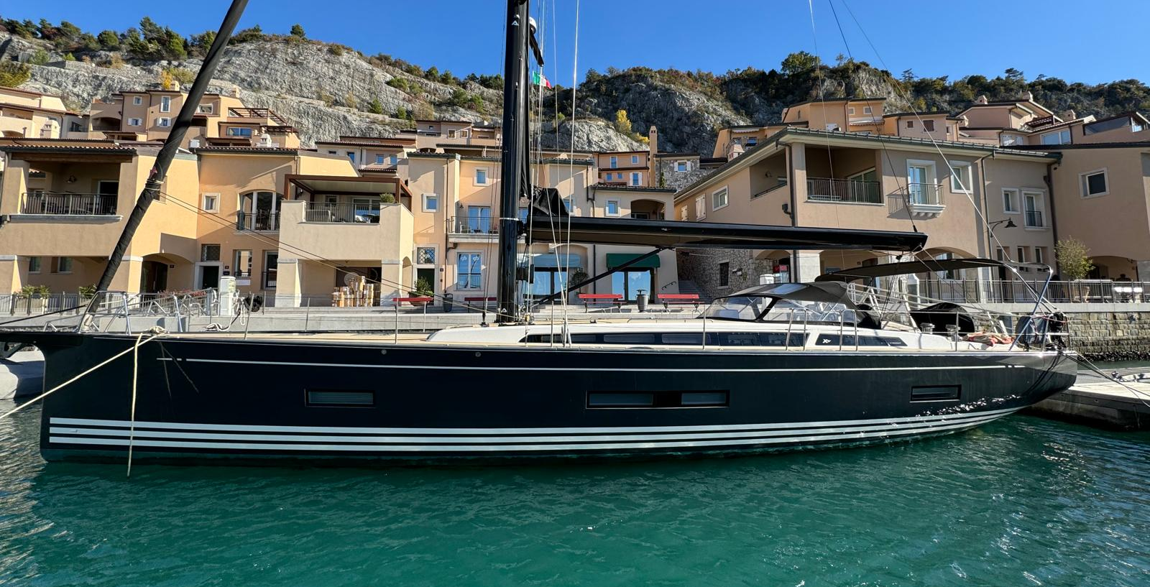
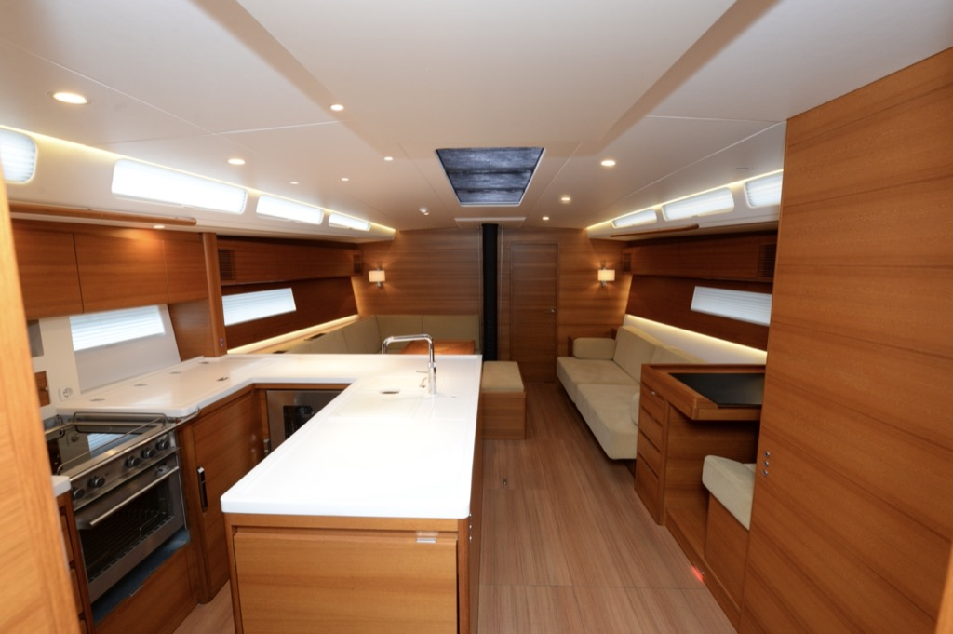
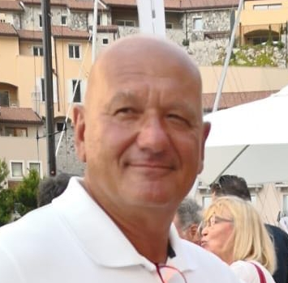
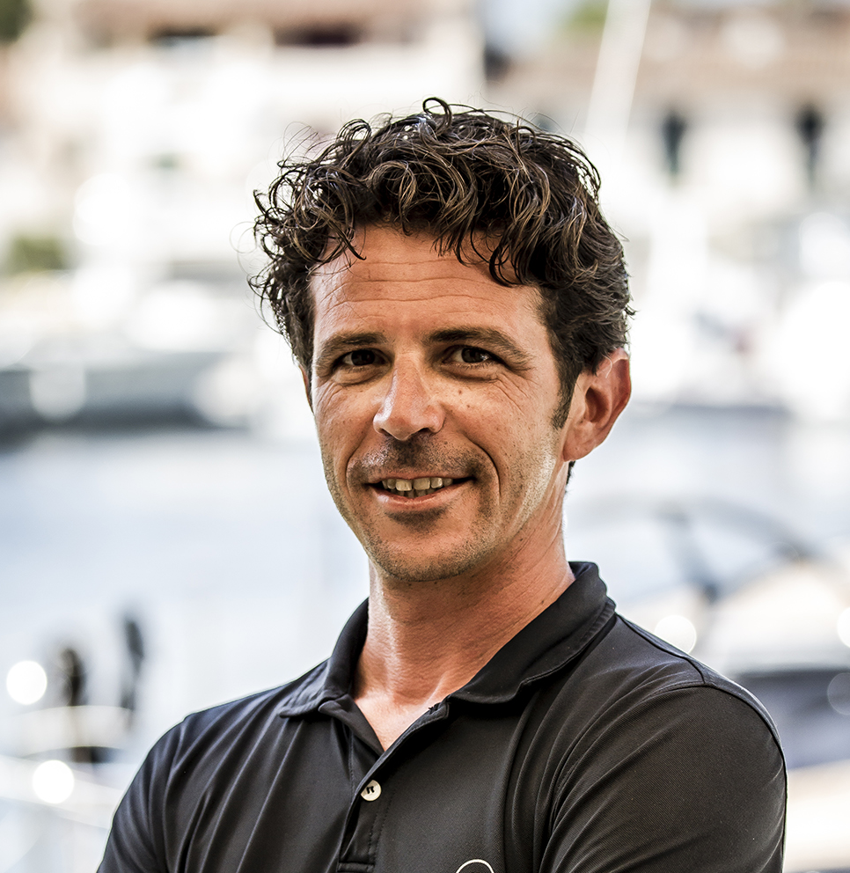
X-YACHTS 5⁶
BOATYARD
X-Yachts Denmark
YEAR
2021
DESIGN
X-Yachts Design Team
LENGHT
17,25 m
Picture
BEAM
4,89 m
DRAFT
2.70 m
DISPLACEMENT
18.8 T
SAIL AREA
159 sqm
FLAG
Denmark
LYING
FANO (Italy)
PRICE
1.280.000 € VAT PAID
SAFETY CERT.
N/A
ENGINE
LAYOUT
Engine
Yanmar with double electronic throttle
Cabins
3
DESCRIPTION
The X56 is a fifty-six-foot high-performance cruising yacht, designed with serious cruising in mind; you could cross the Atlantic or explore the beautiful islands of the Mediterranean. The X56 joins the highly successful and critically acclaimed Pure X range and is now the largest yacht in the range.
Power
110 HP
Beds
6
Work hours/tank
990 h / 600 liters stainless steel
Heads
2
Genset
Fisher Panda 14 Kw
Transom
Garage tender electric transom
Transmission/Propeller
SHAFT / Flexofold 3 blades folding
Sail locker
On bow
INTERIOR AND COMFORT
Interior and floorboards in teak
Full LED interior and exterior lightning
2 Heads with Tecma Silence electric WC
12V USB / 220V sockets in every cabin
electric induction hob with electric oven Microwave oven
90 lt basket fridge with electric opening
Additional 85 lt fridge/freezer with stainless steel door
Samsung combi washing dryer machine
18 bottles wine cooler
Nespresso machine integrated box
Guest cabins with single beds that convertable to double beds
Eberspacher heating system 10 Kw
Air conditioning (3 groups)
Shenker watermaker 100 l/h
Victron Combi inverter and battery charger
Water tank 800 liters
INSTRUMENTS AND ELECTRONICS
AIS
Carbon Lead Service batteries 840 Ah
24 V DC system
14 Kw Fisher Panda Generator (240 h )
Bow and stern thruster command on stb console
2 Yanmar electronic throttles on each console with mechanic backup
FUSION hi-fi system
Yacht controller
B&G H5000 electronic package
Digital compass
2 B&G Nemesis 9’’ multifunction displays on couchroof
1 B&G Nemesis 12’’ mutifunction display on mast
2 B&G Zeus 12’’ plotters on consoles
1 B&G Zeus 16’’ plotter on chart table
2 B&G autopilot
It is offered ready for the buoy at the tourist port of Marina dei Cesari a Fano
SAFETY AND ACCESSORIES
Post cured gelcoat finish Black Grey (RAL 7021)
White gelcoat cove lines
2 rudder wheels and 2 blades
Bigger consoles
Black Sprayhood and helmsman bimini
Full Cockpit cushions
Foldable amidship cleats
Winter cover for deck
Bow and stern thruster
Cockpit table with insulated compartment
Electric OPACMARE 2,5 m telescopic gangway
Boom ligh
Delta anchor SS 25 Kg with 50 m SS chain
2,80 m tender with central console
Anchor locker washing pipe
Fenders and mooring light
EXTERIOR LAYOUT AND RIGGING
Piero Sermenghi
Tel. +39 335 6363616
psermenghi@cantieredelpardo.com
Synthetic full deck
Axxon Carbo mast
Furlerboom electric boom with cover
Rod rigging
Selden electric jib furler
Reckmann electric Code 0 furler
Reckmann electric staysail furler
Harken electric hydraulic unit
4 electric Handersen winches (two speed)
Electric mainsail traveller adjuster with consoles command
SAILS
ONE SAILS Forte 4T Mainsail
ONE SAILS Forte 4T Jib
ONE SAILS Forte 4T staysail
ONE SAILS code 0
ONE SAILS gennaker
Francesco Spirito
Tel. +39 349 4065157
fspirito@cantieredelpardo.com
Cantiere Del Pardo SPA – Via F.lli Lumiere 34 – 47122 Forli’- Italy
Tel: +39 0543 782404 - email: info@cantieredelpardo.com - www.grandsoleil.net

